Slide 1
MPI Communications

Slide 2
MPI Point-to-Point Communication
Uses send and receive routines with message tags (and communicator).
Wild card message tags available

Slide 3
MPI Blocking Routines
Return when “locally complete” - when location used to hold message can be used again or altered without affecting message being sent.
Blocking send will send message and return - does not mean that message has been received, just that process free to move on without adversely affecting message.

Slide 4
Parameters of blocking send
MPI_Send(buf, count, datatype, dest, tag, comm)
Address of
Datatype of
Message tag
send b
uff
er
each item
Number of items
Rank of destination
Comm
unicator
to send
process

Slide 5
Parameters of blocking receive
MPI_Recv(buf, count, datatype, src, tag, comm, status)
Status
Address of
Datatype of
Message tag
after oper
ation
receiv
e b
uff
er
each item
Maxim
um n
umber
Rank of source
Comm
unicator
of items to receiv
e
process

Slide 6
Example
To send an integer x from process 0 to process 1,
MPI_Comm_rank(MPI_COMM_WORLD,&myrank); /* find rank */
if (myrank == 0) {
int x;
MPI_Send(&x, 1, MPI_INT, 1, msgtag, MPI_COMM_WORLD);
} else if (myrank == 1) {
int x;
MPI_Recv(&x, 1, MPI_INT, 0,msgtag,MPI_COMM_WORLD,status);
}

Slide 7
MPI Nonblocking Routines
Nonblocking send - MPI_Isend() - will return “immediately” even before source location is safe to be altered.
Nonblocking receive - MPI_Irecv() - will return even if no message to accept.

Slide 8
Nonblocking Routine Formats
MPI_Isend(buf,count,datatype,dest,tag,comm,request)
MPI_Irecv(buf,count,datatype,source,tag,comm, request)
Completion detected by MPI_Wait() and MPI_Test().
MPI_Wait() waits until operation completed and returns then.
MPI_Test() returns with flag set indicating whether operation completed at that time.
Need to know whether particular operation completed.
Determined by accessing request parameter.

Slide 9
Example
To send an integer x from process 0 to process 1 and allow process 0 to continue,
MPI_Comm_rank(MPI_COMM_WORLD, &myrank); /* find rank */
if (myrank == 0) {
int x;
MPI_Isend(&x,1,MPI_INT, 1, msgtag, MPI_COMM_WORLD, req1);
compute();
MPI_Wait(req1, status);
} else if (myrank == 1) {
int x;
MPI_Recv(&x,1,MPI_INT,0,msgtag, MPI_COMM_WORLD, status);
}

Slide 10
Deadlock
Deadlock: process waiting for a condition that will never become true
Easy to write send/receive code that deadlocks
  Two processes: both receive before send
  Send tag doesn’t match receive tag
  Process sends message to wrong destination process

Slide 11
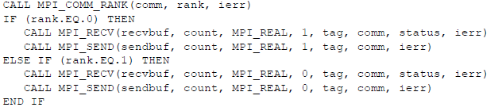

Slide 12
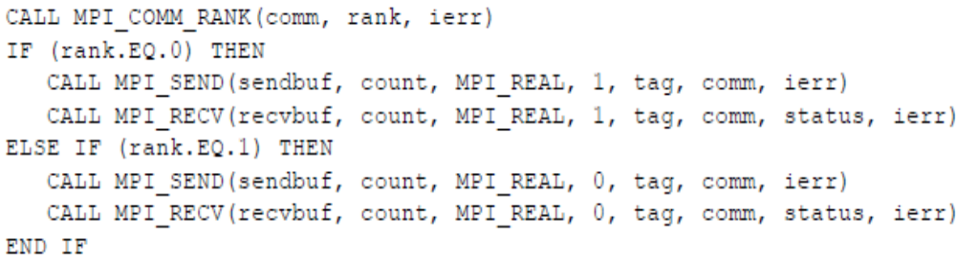

Slide 13
MPI Collective Communications
All processes in the input communicators MUST participate
Are often implemented using point-to-point communication functions

Slide 14
Broadcast
Sending same message to all processes concerned with problem.
Multicast - sending same message to defined group of processes.
Process 0
Process 1
Process
p
-
1
data
data
data
Action
buf
bcast();
bcast();
bcast();
Code
int MPI_Bcast( void *buffer, int count, MPI_Datatype datatype, int root, MPI_Comm comm )

Slide 15
Reduce
Gather operation combined with specified arithmetic/logical operation.
Example: Values could be gathered and then added together by root:
Process 0
Process 1
Process
p
-
1
data
data
data
Action
buf
+
reduce();
reduce();
reduce();
Code
int MPI_Reduce(void *sendbuf, void *recvbuf, int count, MPI_Datatype datatype, MPI_Op op, int root, MPI_Comm comm)

Slide 16
Scatter
Sending each element of an array in root process to a separate process. Contents of ith location of array sent to ith process.
Process 0
Process 1
Process
p
-
1
data
data
data
Action
buf
scatter();
scatter();
scatter();
Code
int MPI_Scatter(void *sendbuf, int sendcnt, MPI_Datatype sendtype, void *recvbuf, int recvcnt, MPI_Datatype recvtype, int root, MPI_Comm comm)

Slide 17
Gather
Having one process collect individual values from set of processes.
Process 0
Process 1
Process
p
-
1
data
data
data
Action
buf
gather();
gather();
gather();
Code
int MPI_Gather(void *sendbuf, int sendcnt, MPI_Datatype sendtype, void *recvbuf, int recvcnt, MPI_Datatype recvtype, int root, MPI_Comm comm)

Slide 18
